Slide 1
WRAP UP REPORT
#BOSSTV VIEWING PARTY
THE
DTL
NTWRK
THE POWER TO DICTATE TRENDS

Slide 2
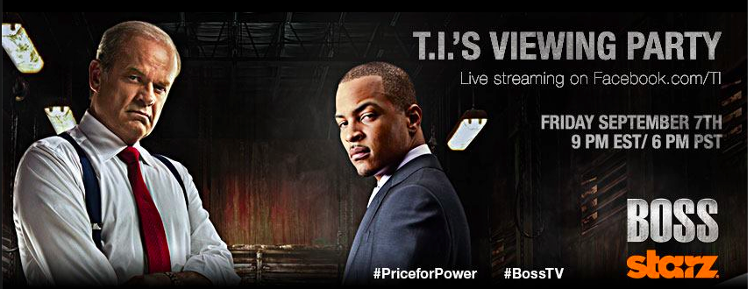
OVERVIEW
Starz hired THE DGTL NTWRK to help draw awareness to the show BOSS.
Through social media mentions and a live viewing party with the two main cast members, Kelsey Grammer and T.I., the hashtag #BOSSTV was pushed out.

Slide 3
THE
DGTL
NTWRK
KEY TERMS THE NTWRK WAS ASKED TO USE:
#BOSSTV
@BOSS_STARZ
OUTLETS USED:
FACEBOOK: Facebook.com/TI
TWITTER: Twitter.com/TIP, Twitter.com/BOSS_STARZ
SPREECAST: Spreecast.com/events/tiviewing-party

Slide 4
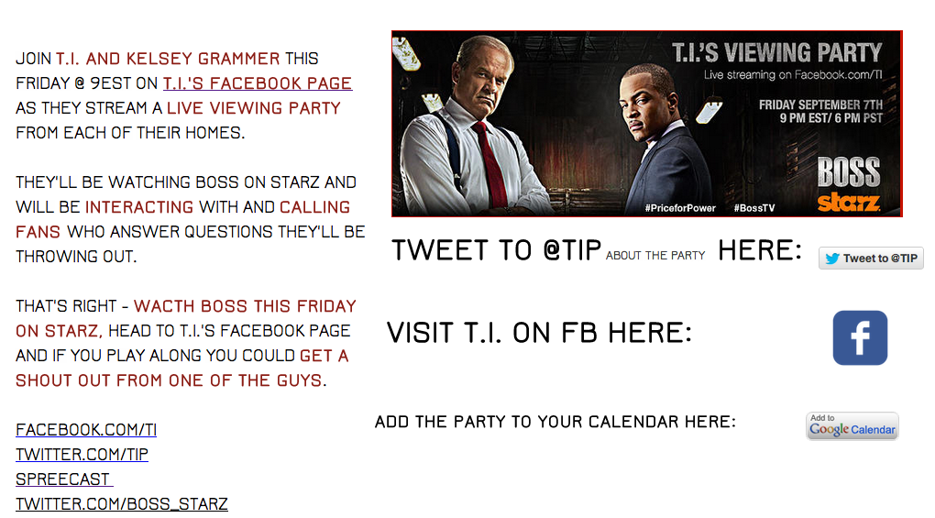
#BOSSTV INFO PAGE was created
THE FOLLOWING WEBPAGE WAS CREATED TO HOST INFORMATION ABOUT THE PARTY & WAS PUSHED OUT TO FANS.

Slide 5
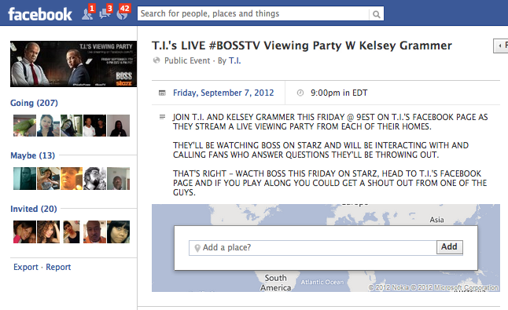
FACEBOOK EVENT was created

Slide 6
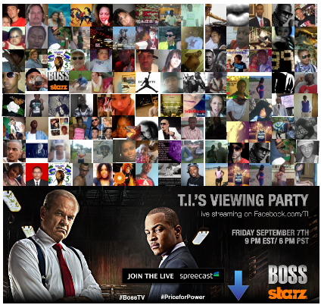
REWARDS FOR PARTICIPANTS were created
THIS MOSAIC POST WAS MADE UP OF FAN PROFILE PICS OF FANS WHO HELPED US PROMOTE. FANS FOUND THEMSELVES, LOVED IT AND SHARED IT ON THEIR WALLS.

Slide 7
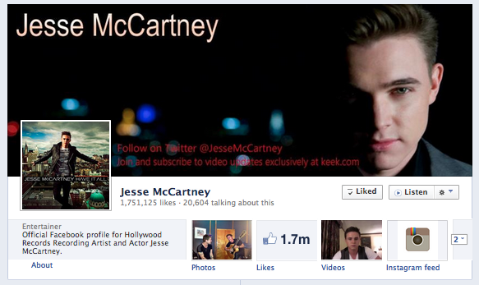
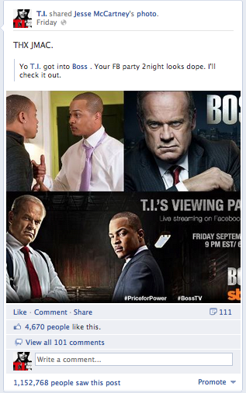
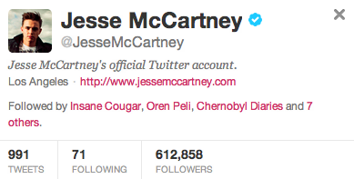
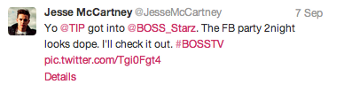
ENGAGED CELEB / SITES MENTIONED ON / REACH
JESSE MCCARTNEY
Facebook 1.8mm Twitter 600K

Slide 8
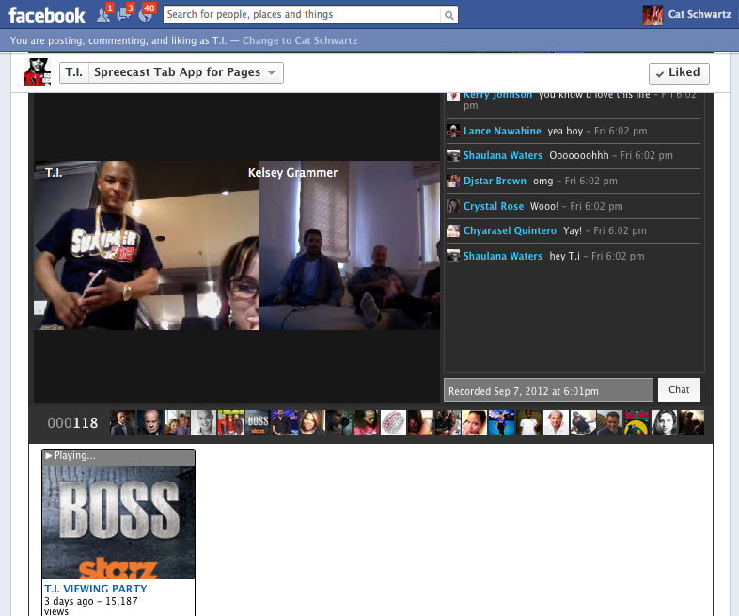
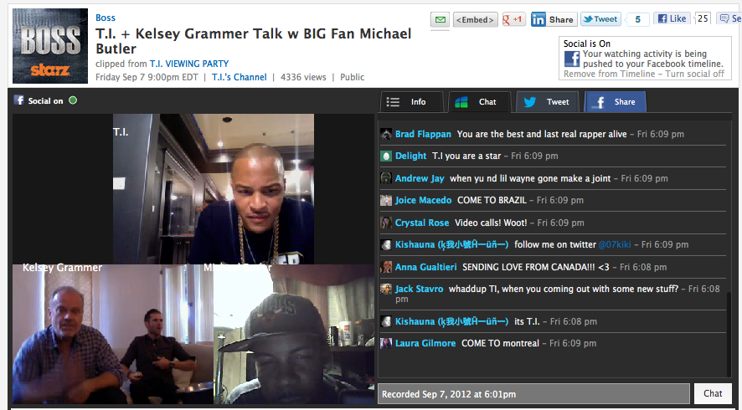
SPREECAST LIVE & CLIPS
THE LIVE EVENT HAPPENED AND THEN CLIPS WERE CREATED AND PUSHED OUT THROUGHOUT THE WEEKEND.

Slide 9
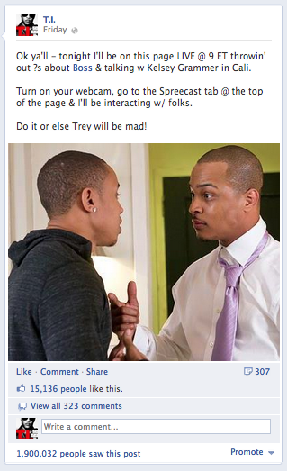
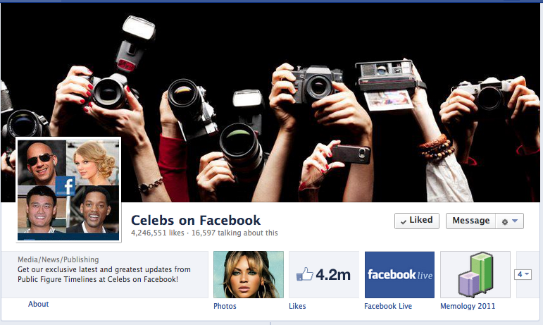
HELP FROM FACEBOOK
SECURED FACEBOOK PROMOTING THE PARTY ON THEIR CELEBS FAN PAGE
THE PAGE HAS 4.2MM FANS.

Slide 10
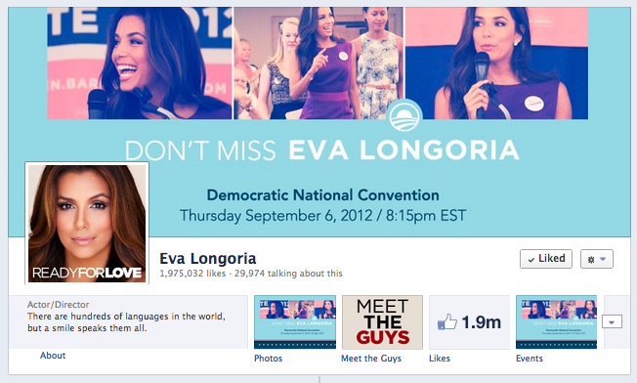
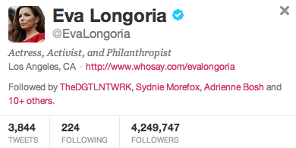
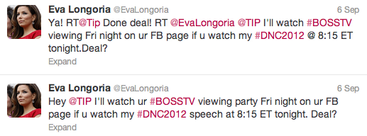
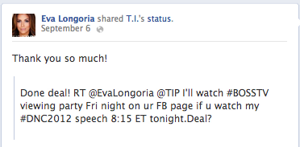
THE
DGTL
NTWRK
EVA LONGORIA
Twitter 4.2 MM Facebook 1.9 MM

Slide 11
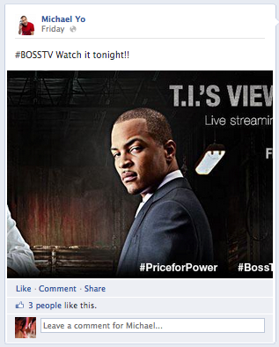
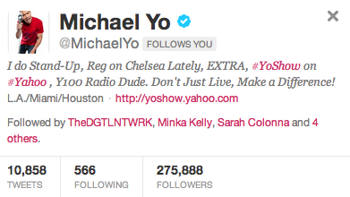
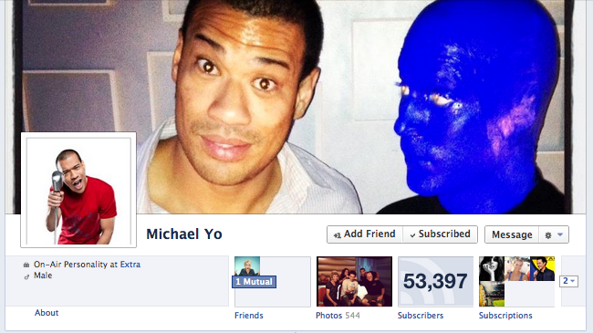

THE
DGTL
NTWRK
MICHAEL YO
Twitter 275,813 FACEBOOK: 53K

Slide 12
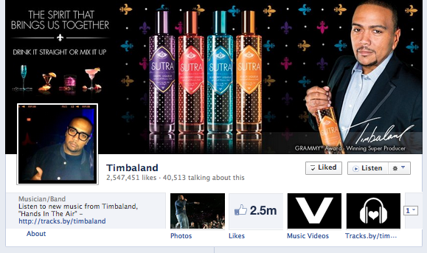
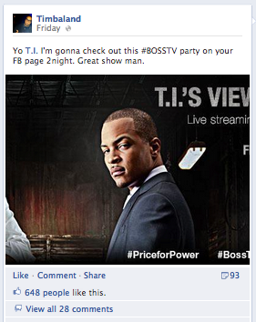
THE
DGTL
NTWRK
TIMBALAND
Facebook 2.5 MM

Slide 13
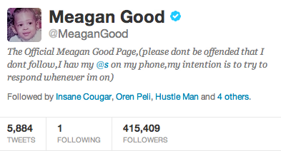
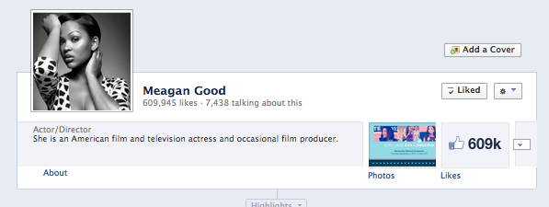
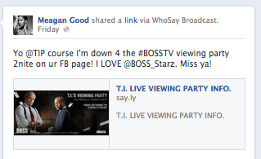

THE
DGTL
NTWRK
MEAGAN GOOD
Twitter 413,672 Facebook 608,293

Slide 14
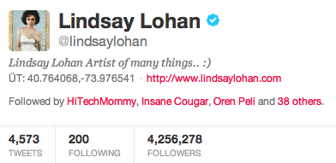
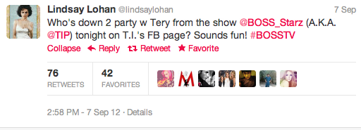
THE
DGTL
NTWRK
LINDSAY LOHAN
Twitter 4.2 MM

Slide 15
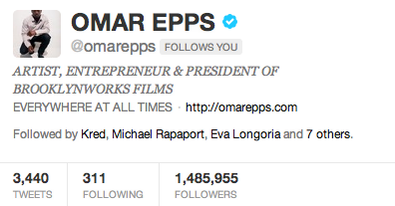

THE
DGTL
NTWRK
OMAR EPPS
Twitter 1.4MM

Slide 16
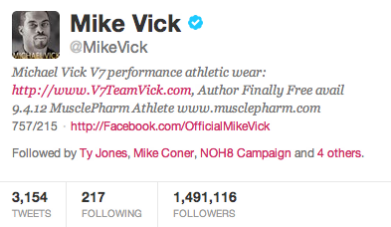
THE
DGTL
NTWRK
MICHAEL VICK
Twitter 1.5mm

Slide 17
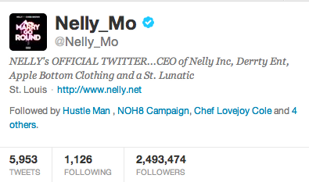
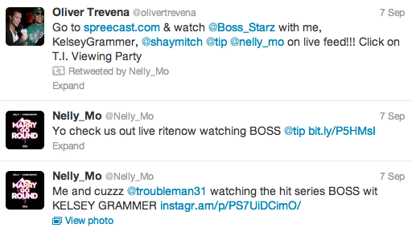
THE
DGTL
NTWRK
NELLY
TWITTER 2.4MM

Slide 18
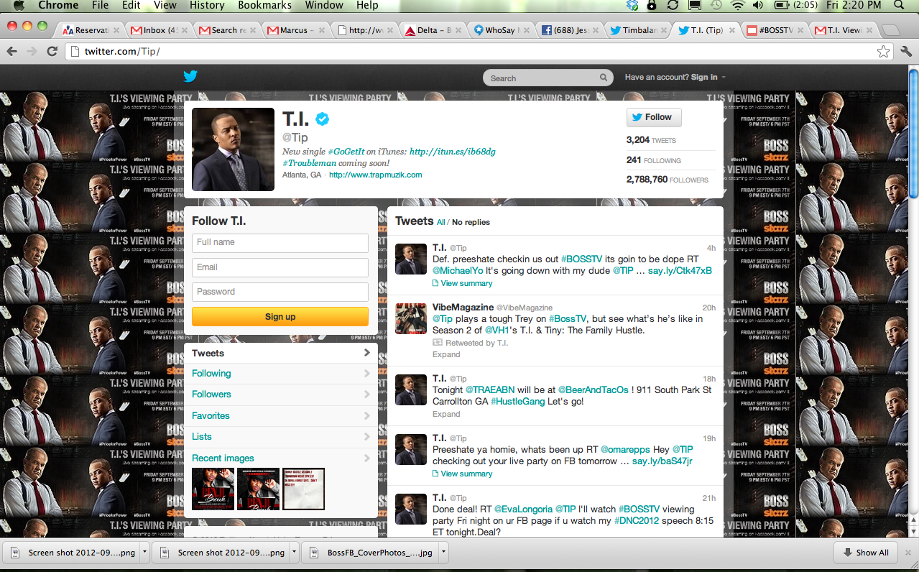
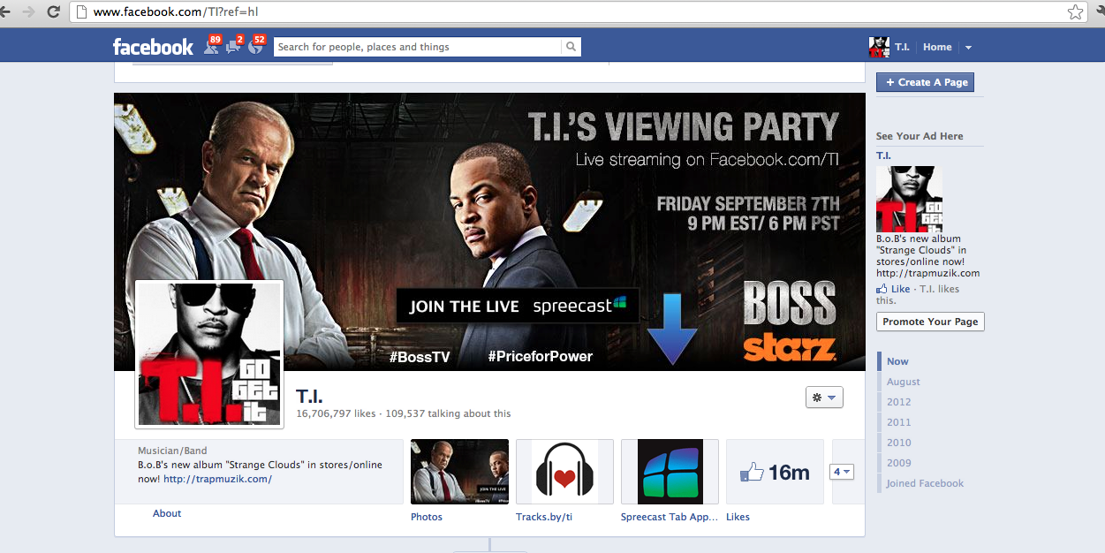
THE
DGTL
NTWRK
T.I.
Facebook 16m Twitter 2.8

Slide 19
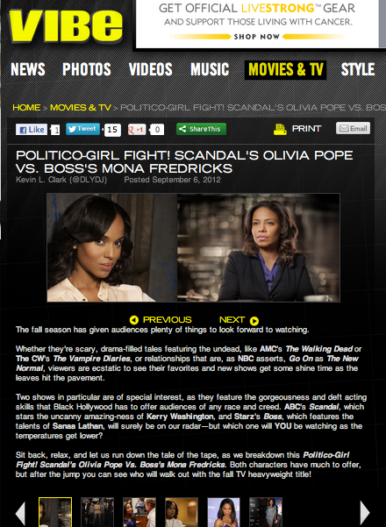
THE
DGTL
NTWRK
VIBE Magazine:

Slide 20
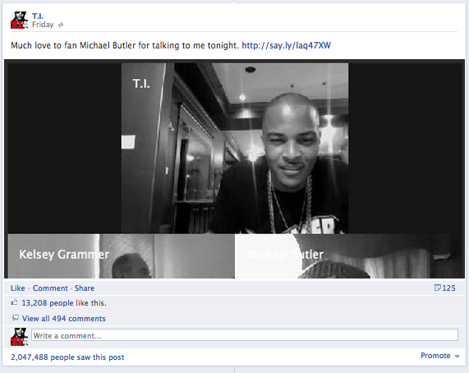
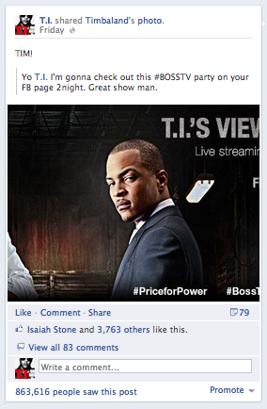
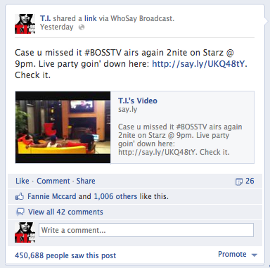
THE
DGTL
NTWRK POSTS THROUGHOUT WEEKEND

Slide 21
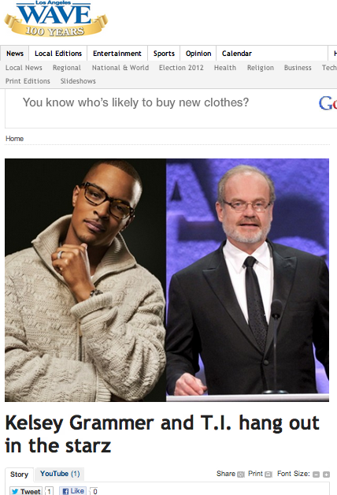
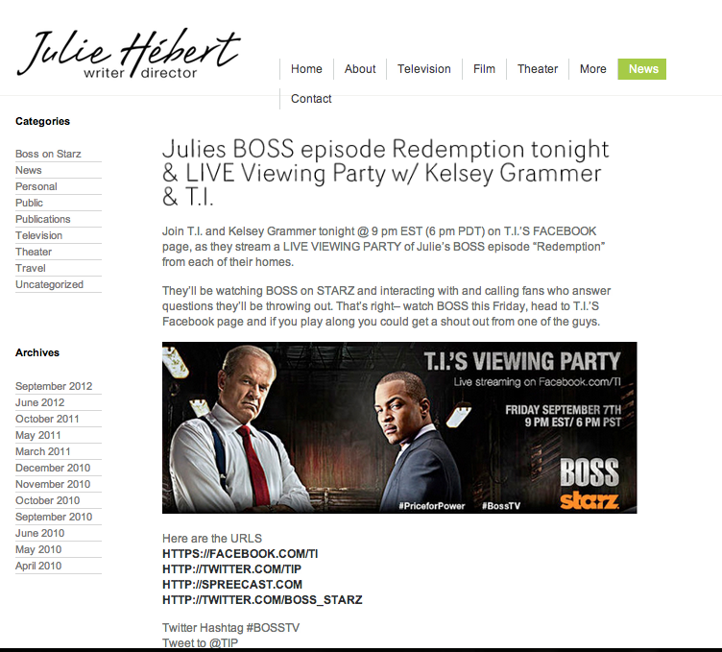
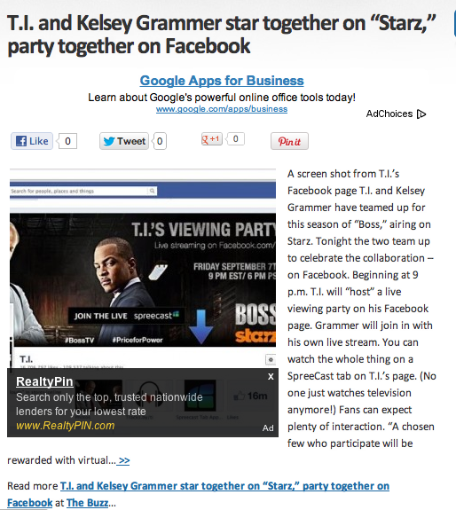
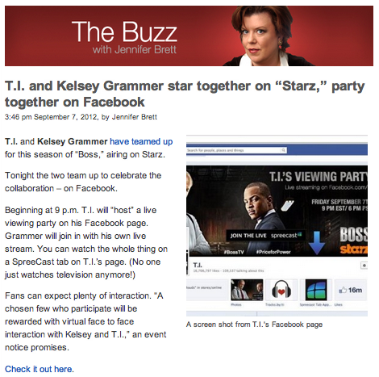
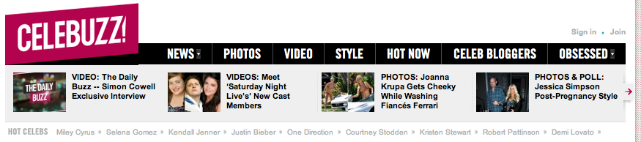

PRESS ABOUT THE EVENT
V

Slide 22
#BOSSTV - REACH
THE HASHTAG #BOSSTV WAS SENT OUT TO OVER 42MM+ FANS
THE SPREECAST VIEWING PARTY WAS SEEN BY 15K+ VIEWERS.

Slide 23
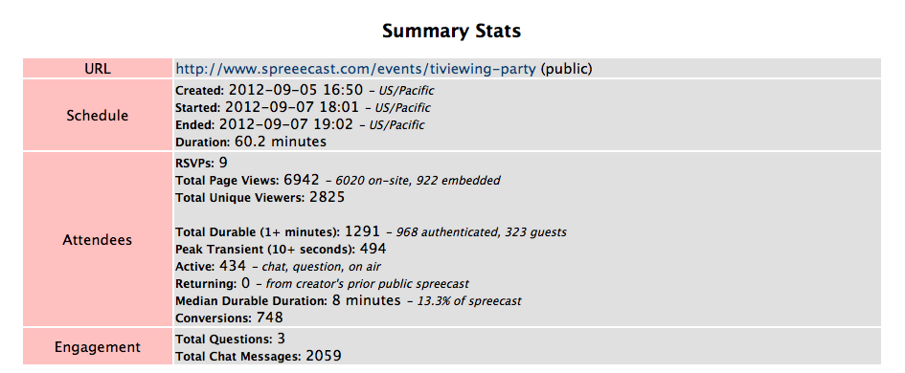
SPREECAST REPORT
15K VIEWS

Slide 24
WHAT I'D CHANGE
1- LIVE CHAT AFTER THE SHOW
SO THAT ALL INVOLVED COULD HAVE ENJOYED THE PROGRAM
WOULD HAVE ONLY NEEDED TALENT FOR 30 MIN
WOULD HAVE BEEN ABLE TO FOCUS MORE ON ACTUALLY ANSWERING THE QUESTIONS
2- THIS TYPE OF THING IS A BUILD AND NEEDS TO HAPPEN EACH SHOW TO MAKE A DIFFERENCE IN THE RATINGS. GETTING TALENT TO DO IT MAY BE HARD BUT IF YOU CAN DO IT AFTER EACH SHOW IT WILL HAVE MORE OF A CHANCE TO CATCH ON.
3- PROMOTION THROUGH LARGER AVENUES WILL BE IDEAL
ON SCREEN DURING THE SHOW
IN PRINT
ON BLOGS

Slide 25
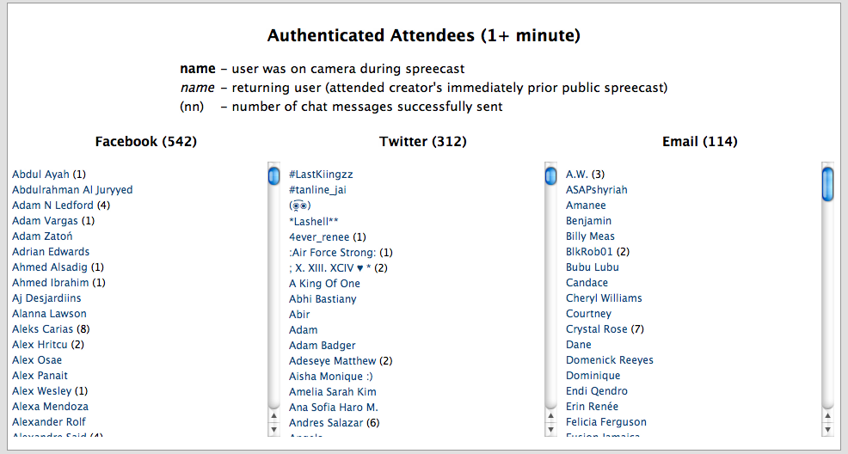
USING THE INFO
THROUGH SPREECAST/FB/TWITTER YOU NOW HAVE ACCESS TO EVERYONE'S CONTACT INFO WHO PARTICIPATED. THIS CAN BE USED IN MANY WAYS TO INCREASE VIEWERSHIP.

